Slide 1
Week 3: outline
2.1 principles of network applications
2.2 Web and HTTP
2.3 FTP
2.4 electronic mail
  SMTP, POP3, IMAP
2.5 DNS
2.6 P2P applications
2.7 socket programming with UDP and TCP
Application Layer
2-<number>

Slide 2
Some network apps
e-mail
web
text messaging
remote login
P2P file sharing
multi-user network games
streaming stored video (YouTube, Hulu, Netflix)
voice over IP (e.g., Skype)
real-time video conferencing
social networking
search
…
…
Application Layer
2-<number>

Slide 3

















Creating a network app
application
transport
network
data link
physical
write programs that:
run on (different) end systems
communicate over network
e.g., web server software communicates with browser software
no need to write software for network-core devices
network-core devices do not run user applications
applications on end systems allows for rapid app development, propagation
application
transport
network
data link
physical
application
transport
network
data link
physical
Application Layer
2-<number>

Slide 4
Application architectures
possible structure of applications:
client-server
peer-to-peer (P2P)
Application Layer
2-<number>

Slide 5
Client-server architecture
server:
always-on host
permanent IP address
data centers for scaling
clients:
communicate with server
may be intermittently connected
may have dynamic IP addresses
do not communicate directly with each other
client/server
Application Layer
2-<number>

Slide 6
P2P architecture
no always-on server
arbitrary end systems directly communicate
peers request service from other peers, provide service in return to other peers
  self scalability – new peers bring new service capacity, as well as new service demands
peers are intermittently connected and change IP addresses
  complex management
peer-peer
Application Layer
2-<number>

Slide 7
Processes communicating
process: program running within a host
within same host, two processes communicate using inter-process communication (defined by OS)
processes in different hosts communicate by exchanging messages
clients, servers
client process: process that initiates communication
server process: process that waits to be contacted
aside: applications with P2P architectures have client processes & server processes
Application Layer
2-<number>

Slide 8

Sockets
process sends/receives messages to/from its socket
socket analogous to door
  sending process shoves message out door
  sending process relies on transport infrastructure on other side of door to deliver message to socket at receiving process
application
socket
application
controlled by
app developer
process
process
transport
transport
network
network
controlled
by OS
link
Internet
link
physical
physical
Application Layer
2-<number>

Slide 9
Addressing processes
to receive messages, process must have identifier
host device has unique 32-bit IP address
Q: does IP address of host on which process runs suffice for identifying the process?
identifier includes both IP address and port numbers associated with process on host.
example port numbers:
  HTTP server: 80
  mail server: 25
to send HTTP message to gaia.cs.umass.edu web server:
  IP address: 128.119.245.12
  port number: 80
more shortly…
  A: no, many processes can be running on same host
Application Layer
2-<number>

Slide 10
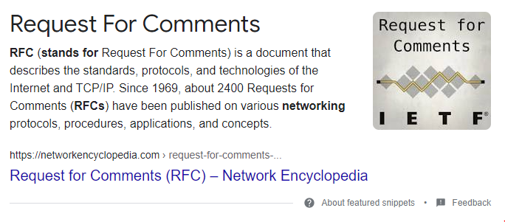
App-layer protocol defines
types of messages exchanged,
  e.g., request, response
message syntax:
  what fields in messages & how fields are delineated
message semantics
  meaning of information in fields
rules for when and how processes send & respond to messages
open protocols:
defined in RFCs
allows for interoperability
e.g., HTTP, SMTP
proprietary protocols:
e.g., Skype
Application Layer
2-<number>

Slide 11
What transport service does an app need?
data integrity
some apps (e.g., file transfer, web transactions) require 100% reliable data transfer
other apps (e.g., audio) can tolerate some loss
throughput
some apps (e.g., multimedia) require minimum amount of throughput to be “effective”
other apps (“elastic apps”) make use of whatever throughput they get
timing
some apps (e.g., Internet telephony, interactive games) require low delay to be “effective”
security
encryption, data integrity, …
Application Layer
2-<number>

Slide 12
Internet transport protocols services
TCP service:
reliable transport between sending and receiving process
flow control: sender won’t overwhelm receiver
congestion control: throttle sender when network overloaded
does not provide: timing, minimum throughput guarantee, security
connection-oriented: setup required between client and server processes
UDP service:
unreliable data transfer between sending and receiving process
does not provide: reliability, flow control, congestion control, timing, throughput guarantee, security, orconnection setup,
Q: why bother? Why is there a UDP?
Application Layer
2-<number>

Slide 13
Internet apps: application, transport protocols
application
layer protocol
SMTP [RFC 2821]
Telnet [RFC 854]
HTTP [RFC 2616]
FTP [RFC 959]
HTTP (e.g., YouTube),
RTP [RFC 1889]
SIP, RTP, proprietary
(e.g., Skype)
underlying
transport protocol
TCP
TCP
TCP
TCP
TCP or UDP
TCP or UDP
application
e-mail
remote terminal access
Web
file transfer
streaming multimedia
Internet telephony
Application Layer
2-<number>

Slide 14
Securing TCP
TCP & UDP
no encryption
cleartext passwds sent into socket traverse Internet in cleartext
SSL
provides encrypted TCP connection
data integrity
end-point authentication
SSL is at app layer
Apps use SSL libraries, which “talk” to TCP
SSL socket API
  cleartext passwords sent into socket traverse Internet encrypted
  See Chapter 7
Application Layer
2-<number>

Slide 15
Chapter 2: outline
2.1 principles of network applications
  app architectures
  app requirements
2.2 Web and HTTP
2.3 FTP
2.4 electronic mail
  SMTP, POP3, IMAP
2.5 DNS
2.6 P2P applications
2.7 socket programming with UDP and TCP
Application Layer
2-<number>

